Slide 1

Real Time Big Data Processing of Tweets via Keywords & GPS Locations
Project Design Presentation
#HotSpot
Kevin Chew Figueroa, Steven Chung, Peter Stretch, Brad Ko, Gregory Lynch, Juan Robles
Electrical & Computer Engineering
California State Polytechnic University Pomona, CA
Notes:
Kevin

Slide 2
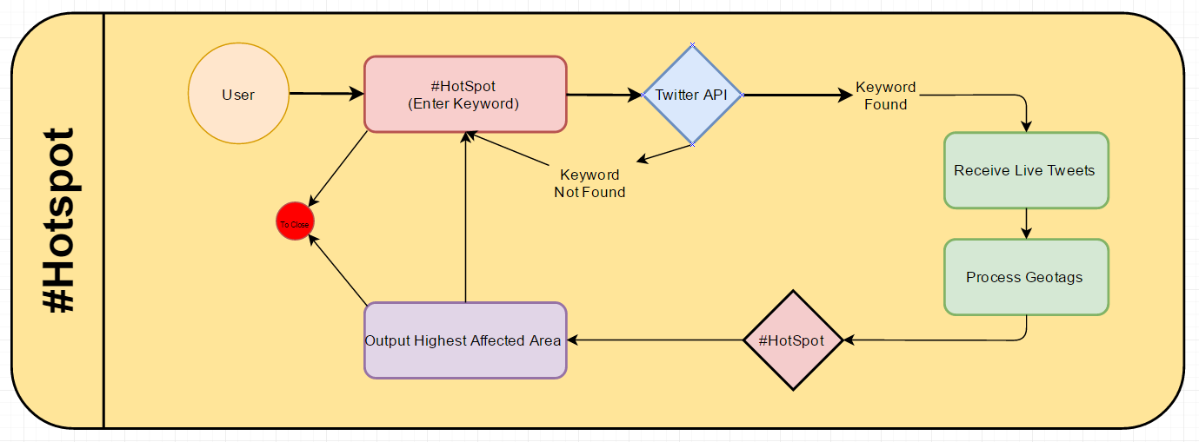
Business Process Model

Slide 3
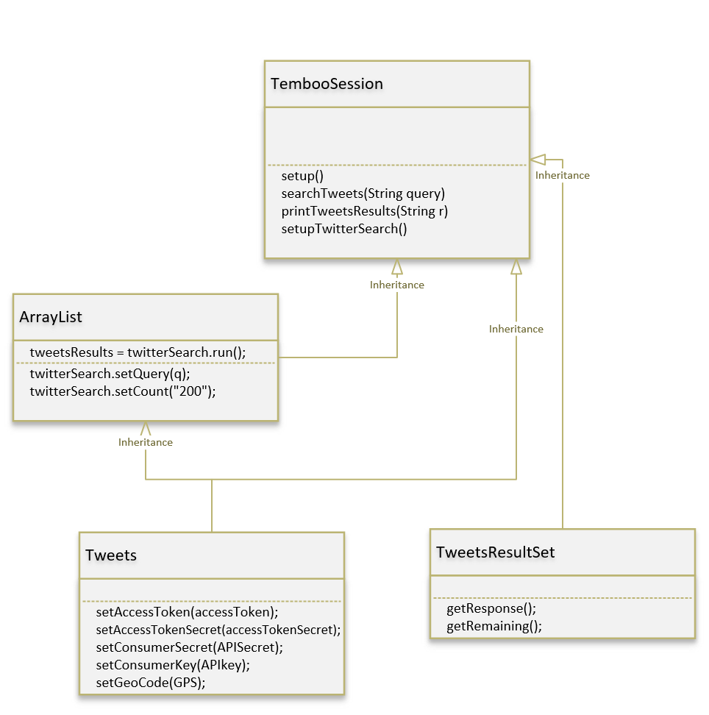
Structure & Class Association
Notes:
At run time, the system will operate via an object of the Temboo Session class, the system’s high-level main. It will call Twitter’s API classes Tweets, TweetsResultSet, and Java’s ArrayList. Doing so, a client will be created and Websocket Connection will be established. Using inheritance, Temboo Session will pull both the user’s search query the requested GPS location, as well as a distance value indicating the search radius that the user wishes to search for these Tweets from the pulled GPS. Over the websocket connection, the system will serialize this input data and send it to the Twitter API server, and the server will send back Tweets matching the search query within the GPS location and its radius. Temboo Session, using ArrayList, will create a stack of the search results which the user can view.

Slide 4
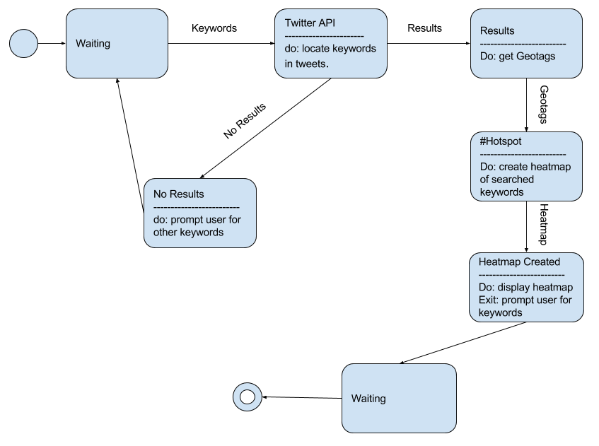
Behavior - Event-Driven Model

Slide 5
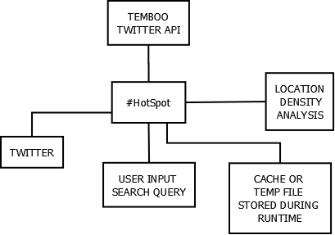
Context Model

Slide 6
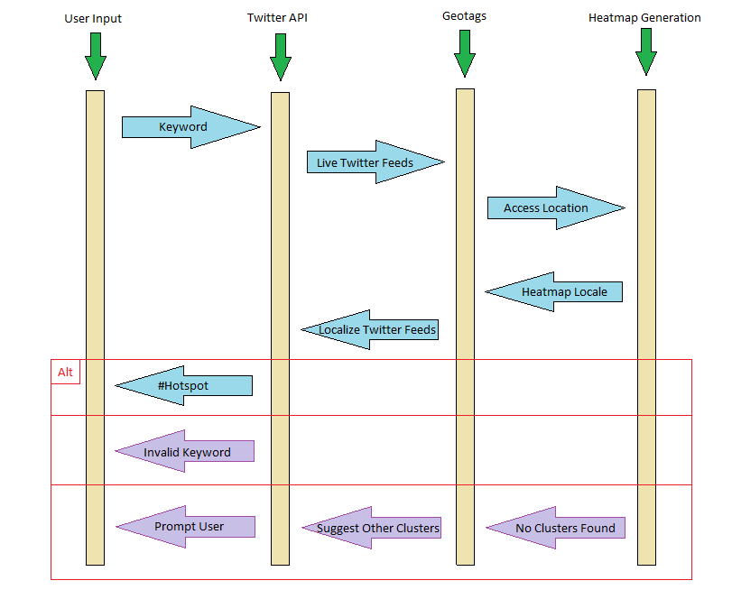
Sequence Diagram

Slide 7


Use Case Diagram for #HotSpot
Input Keyword
User
Twitter API
Return Geotagged Tweets
Filter Tweets
#HotSpot

Slide 8
#HotSpot: Input Keyword
Actors | User, Twitter API
Description | A keyword is inserted into the Twitter API to be searched for in Tweets
Data | A string (the keyword)
Stimulus | User command issued by user
Response | Print statement indicating that the program accepted the keyword and is searching
Comments | The string must be limited to inputs without spaces

Slide 9
#HotSpot: Filter Tweets
Actors | Twitter API, #Hotspot
Description | The Twitter API will read through live or recent tweets and filter tweets by keyword and location
Data | Tweets (messages posted to the public) and location
Stimulus | Twitter API function call
Response | Return tweets that have location and messages with the keyword
Comments | The location will be the first filter as most tweets do not have them

Slide 10
#HotSpot: Return GPS Cluster
Actors | #HotSpot, User
Description | #HotSpot will calculate the “center of gravity” from the GPS clusters and display them to the user
Data | GPS coordinates and the tweets attached to them
Stimulus | Function call
Response | GPS cluster displayed to the user

